Slide 1
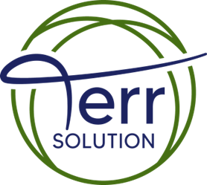
A MULTIDISCIPLINERY PRACTICE

Slide 2
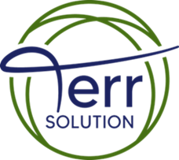
OUR MISSION
“We're in business to save our TERR (earth; land) and bring vision to life through careful planning, design, and implementation”
OUR VALUES
TERR Solutions shared values, like our firm’s name, are derived from the beliefs and convictions of our directors.
TERR Solutions primary goal is to develop a truly sustainable built environment. This means that we aim to identify a balance between the needs of a growing world population and the finite capacity and health of our planet in all our work.
A Multidisciplinary Practice

Slide 3

OUR CORE VALUES
COLLABORATIVE COMMUNICATORS. We listen, learn and solve together.
OVERALL UNITY. We succeed together.
RESPECT & TRUST. We do the right thing for our clients and our team.
EXCELLENCE IN ENGINEERING. We persistently work to find the right solution for the project
A Multidisciplinary Practice

Slide 4

Terr Solutions Ltd is a multidisciplinary practice comprising
Chartered Architects
Structural Engineers
Civil Engineers
Mechanical Engineers
Electrical Engineers
Public Health Engineers
Asset Management Consultants
“Terr Solutions is a RIBA chartered and ISO 9001 accredited consultancy.”

Slide 5
OUR DESIGN APPROACH
Define Vision & Drivers – Uncover the project’s strategic, aspirational, and commercial objectives, developing cost-efficient design options for informed decision making.
Align Stakeholders – Establish a clear, unified design intent, agreed and understood by both client and delivery team.
Deliver with Precision – Produce timely, accurate, and visually compelling documentation, providing responsive solutions optimised for economic, functional, and aesthetic excellence.
"Bringing the built environment in line with planetary limits."

Slide 6
OUR SERVICE TO CLIENTS
We deliver a highly personal and responsive service, partnering closely with clients and design teams to develop tailored solutions at every stage of a project. Combining deep expertise with genuine passion, we continually push the boundaries of design and service excellence.
Through proactive collaboration with developers, architects, and construction professionals, we consistently achieve successful project outcomes — often realising substantial time, cost, and risk reductions.
“Offering a wide range of services across Civil and Structural Engineering projects enables us to offer a unique well-rounded service to our clients.”

Slide 7
OUR DRIVE FOR SUSTAINABILITY
Design for Planetary Limits – Integrate low-carbon, sustainable materials and optimise building systems for exceptional lifecycle performance.
Prioritise Reuse – Favour renovation and adaptive reuse of existing structures wherever possible.
Maximise Resource Value – When redevelopment is necessary, apply deconstruction strategies to recycle and repurpose materials at their highest value.
The Building Research Establishment Environmental Assessment Method (BREEAM)

Slide 8
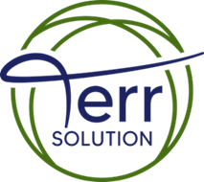
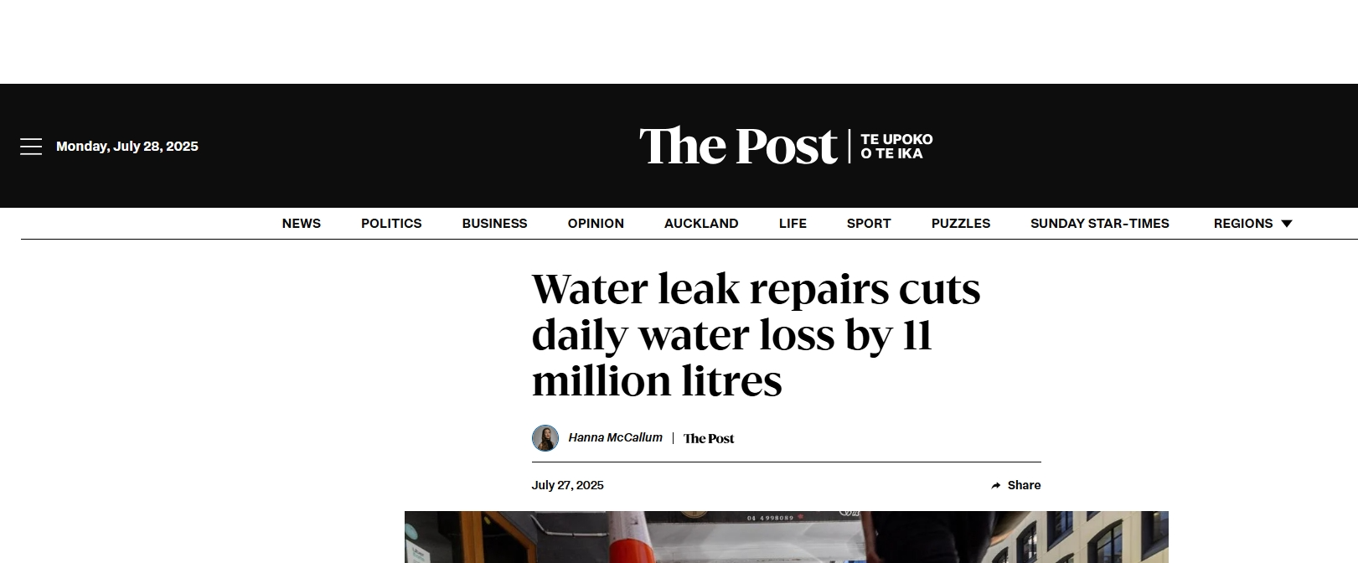
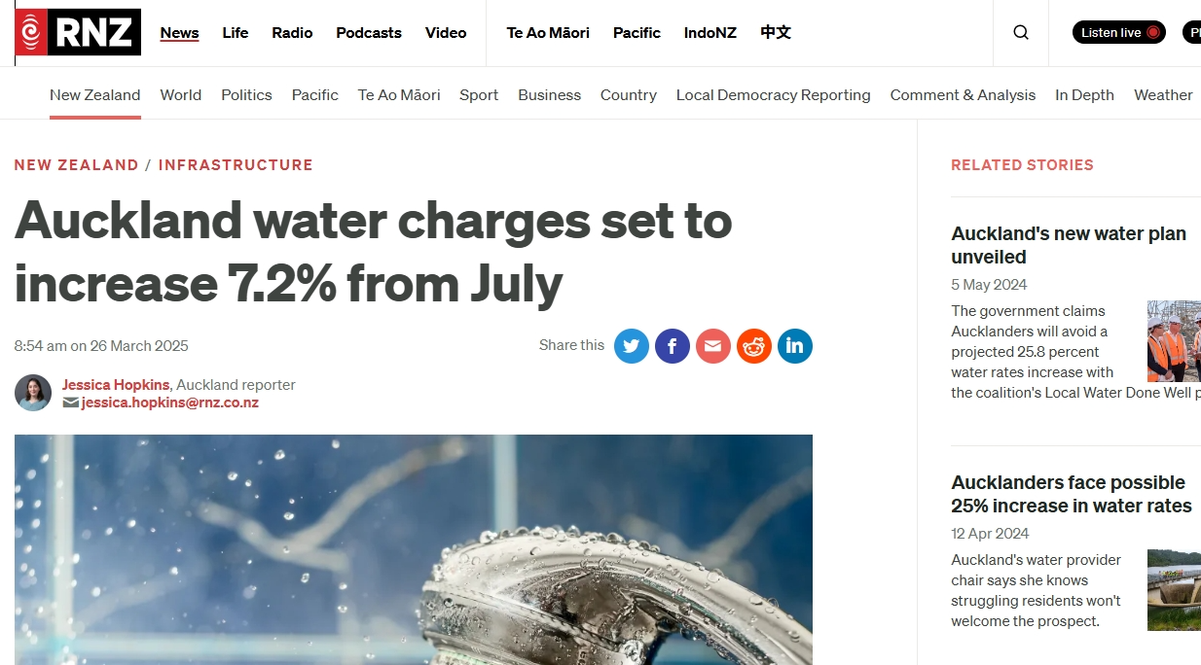
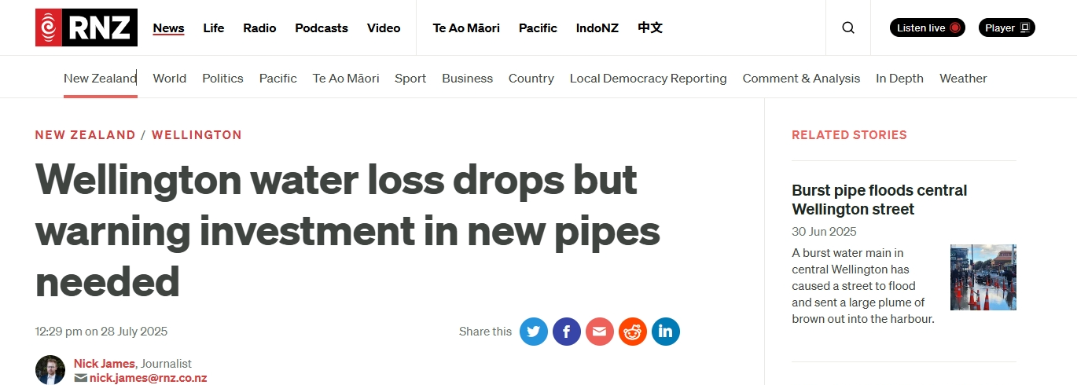
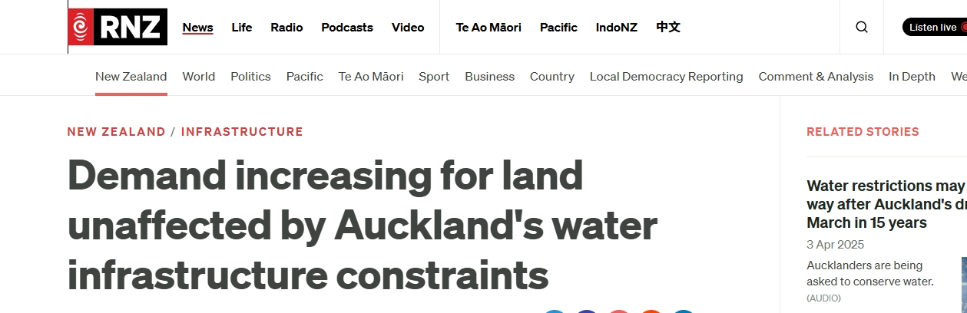
Media coverage
A Multidisciplinary Practice

Slide 9

Asset Management
ASSET MANAGER
ASSET PLAN
“LAMP”
ASSET ONWER
Effective asset management not only helps create value but also protects and enhances an organisation’s financial health and sustainability

Slide 10

What Is Asset Management Plan (AMP)
Asset Management Plan (AMP): Tactical framework for managing infrastructure and assets.
Maintains agreed service standards across the asset life cycle.
Multidisciplinary approach to optimise performance and value.
Backbone of a successful, sustainable organisation.
Assets
Service Level
Criticality
Life Cycle
Funding
Local Asset Management Plan
A Multidisciplinary Practice

Slide 11
Key Elements of a successfully implemented AMP
STRATEGY
Policy And Objectives
Asset Management Plan (AMP)
ACTIVITY
Asset Register
Asset Lifecycle Plan
Asset Condition Assessment
Inputs
AMP
Annual Works Plan
Outputs
Asset Criticality
Assessment
Capital Work Plan
SUPPORT
Asset Platform
Training
Finance

Slide 12

THE BENEFITS OF ASSET MANAGEMENT PLANNING
Optimised Asset Use – Track assets throughout their life cycle to improve acquisition, maintenance, and overall performance.
Enhanced Risk Management – Understand asset performance in real time to assess and mitigate risks effectively.
Improved Compliance – Maintain a centralised asset record to simplify reporting and meet regulatory requirements.
Greater Accuracy – Ensure financial statements reflect asset values and status correctly.
Streamlined Inventory – Identify and remove lost, stolen, or damaged assets from records to maintain accuracy.
"Our goal is to protect and enhance the value of your assets while reducing costs and mitigating risks."

Slide 13

Steps to Building an Effective Asset Management Plan and Asset Planning
An asset management plan serves as the cornerstone for an effective asset management system. These plans provide a road map for organizations to understand their objectives and long-term asset management strategy.
Step 1. Complete an asset inventory
🔹 Why it’s important: You can’t manage what you don’t know you have.
🔹 Purpose: Establish a clear baseline for your plan.
The Inventory:
What assets you have
Where they are located
Value of each asset
Date built or purchased
Expected life-cycle

Slide 14
Step 2. Calculate life-cycle costs
Your asset management plan is only as accurate as your life-cycle cost data.
- Beyond Purchase Price - Maintenance - Capital Upgrades
- Performance Modelling - Disposal Costs
Step 3. Calculate Risk costs
Risk costs rise when service levels fall short.
Link service levels to quality, capacity, function & safety
Identify operating, maintenance & renewal needs
Consider:
Current service level
Expected changes
Annual cost
Funding availability
User needs & expectations
Understanding service levels helps quantify and manage risk costs

Slide 15
Step 4. Apply cost-effective management
Are you managing your assets in a proactive or reactive manner?
In most cases, proactive management is more cost-effective in the long-run than reactive management. For example, if you wait until there is a bad heating pump on one of your building before performing pump maintenance, you can end up spending more money than if you proactively conduct pump maintenance over time. You’re practicing cost-effective management when you do the most cost-effective maintenance, repair or replacement at the right time during the entire asset life-cycle.
Step 5. Execute long-term financial planning
Your asset management should naturally translate into long-term financial planning. A long-term financial plan will help you determine which of your objectives are feasible, which are important and which can maintain your priority assets over the long term.

Slide 16

Our Approach to Asset Management
Our aim is to ensure we safeguard your asset performance, integrity and resilience in the delivery of water and wastewater services.
Developing asset strategies and plans that optimise performance, risk and efficiency and provide best value for your customers, stakeholders and environment.
Providing a sustainable and efficient asset base to achieve our environmental commitments.
Adopting a systems-thinking approach which considers short to long term perspectives and resilience across all business planning cycles.
Maintaining and continually improving data, insight, and tools so that your investment decisions are supported and evidence based.
Planning and prioritising the resources needed to operate your asset management system and meet your objectives.
Driving continual improvement of your asset management maturity through collaboration with the utility sector, your stakeholders and partnerships and seek new opportunities to innovate

Slide 17
Asset Management System
Your Asset Management System (AMS) will be hosted on your internal Sharepoint site. Your AMS is inclusive of physical assets owned and managed and used directly for the provision of water and wastewater services:
• Clean water network assets
• Clean water production assets
• Wastewater network assets
• Wastewater treatment assets
• Sludge treatment centres
• Renewable power regeneration
• On site buildings
• Telecommunications
This is inclusive of the following activities:

Slide 18
Asset Management System
This is inclusive of the following activities:
Strategic asset management (inc. asset planning, capacity studies, system review, water
resource management planning)
• Investment activities following on from front line identification through to solution design
and project definition
• Inspection, operation, maintenance and design of assets
• Asset data linked to all activities
• Delivery of enablers to support framework
• Procurement (inc. acquisition), monitoring, reporting, decommissioning and disposal

Slide 19
Collect - Understand - Deliver together
Goal #1: Increase quantity and quality of maintenance data
Current state | End state | Strategy
Manual data collection Inaccessible data Infrequent reporting cycles Lack of useful maintenance metrics | Automated data collection Centralized, accessible data Consistent reporting cycles Maintenance metrics incorporated into decision making | Set up a system to centralise and automate data collection Automatically generate and share reports on a weekly basis Create a dashboard of shared metrics for maintenance and operations
A Multidisciplinary Practice

Slide 20
Collect - Understand - Deliver together
Goal #2: Increase understating asset performance and consequence of failure
Current state | End state | Strategy
Manual data collection Inaccessible data Infrequent reporting cycles Lack of useful maintenance metrics | Automated data collection Centralised, accessible data Consistent reporting cycles Maintenance metrics incorporated into decision making | Set up a system to centralise and automate data collection Automatically generate and share reports on a weekly basis Create a dashboard of shared metrics for maintenance and operations
A Multidisciplinary Practice

Slide 21
Collect - Understand - Deliver together
Goal #3: Increase understating asset performance and consequence of failure
Current state | End state | Strategy
Fire fighting and add hoc fixing Duplicating work Huge financial loss or commitments Negative PR and public perceptions | Well planed and programmed work Better finical forecast ans control Value for money delivery process. More positive press coverage and public perception. | Develop Authentic and AI knowledge models. Automatically generated short, medium and long term capital programme. Link the asset health factor into the financial planning system. Develop system to share the Pain and gain major and minor capitol delivery projects.
A Multidisciplinary Practice

Slide 22












Benefit VS Cost
BENEFIT
Yr 2
Yr 5
Yr 7
Yr 10
Yr 12
Yr 15
COST
A Multidisciplinary Practice

Slide 23
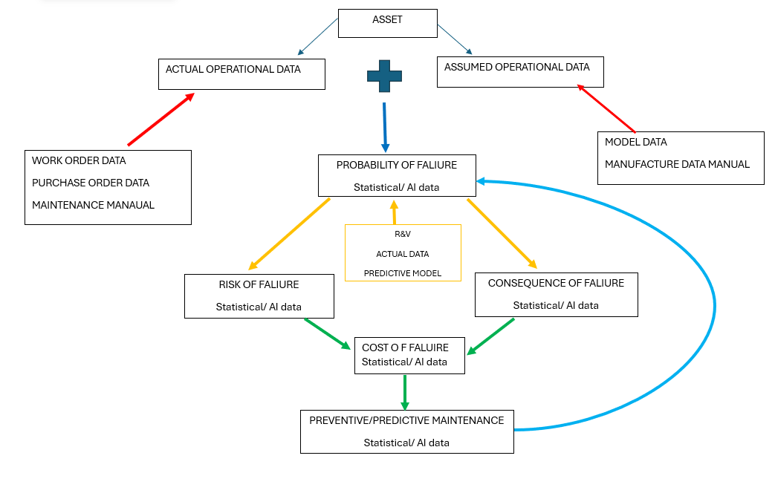
Asset Health Process
A Multidisciplinary Practice

Slide 24
How we use your catchment data to identify partnership
Contributing area mapping of surface water connectivity
comprehensive maps of the public sewer assets
day-to-day Sewerage Management Planning (SMP)
hydraulic sewer modelling coverage which is supported by
contributing area mapping to inform sw connectivity.
connections to third party assets
(e.g. highway drains, culverted watercourses etc)
Use of Flooding Incident Data
A Multidisciplinary Practice

Slide 25
AMP Deliverables……..and tools
Building surveys and master plans
Sustainability master plan
Actual carbon reduction identification
Energy reduction and cost savings
Eliminating work duplication.
CAPEX and OPEX savings.
Asset inventory + tagging = Reliable data
Asset owner/management workshop
Risk ranking
Asset plan data base
Enhanced Reporting
A Multidisciplinary Practice

